Slide 1
Handshake Supervisor Training
Presented by The Career Development Center

Slide 2

Agenda
Creating a Handshake Account
Posting a Job in Handshake
Accessing your Applicants
Expiring and Duplicating Job postings
Handshake Support and Resources

Slide 3
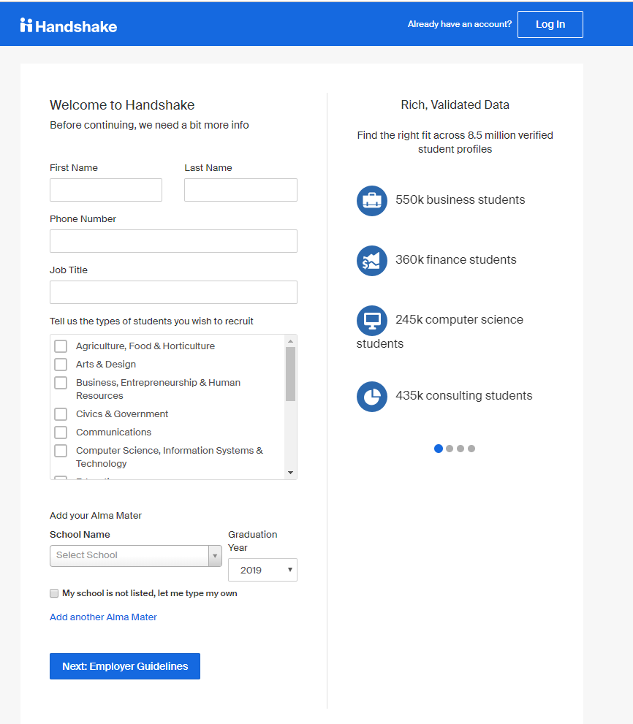
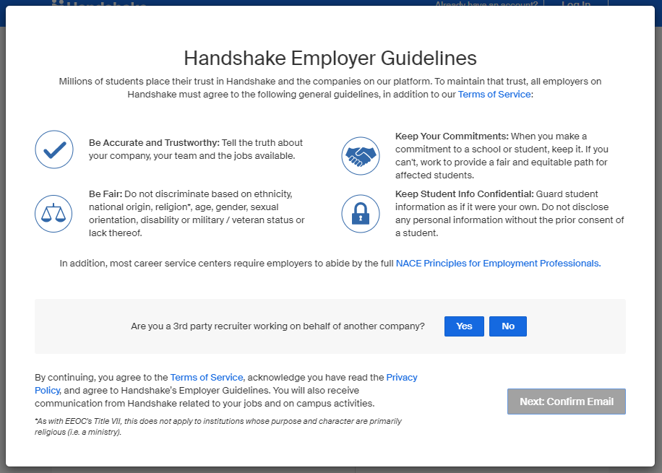
Create a Handshake Account pt. 1
How to:
To create your account, go to: app.joinhandshake.com/employer_registrations/new
Make sure you use your UTA email.
  Single Sign On IS NOT supported for faculty/staff Handshake accounts.
Fill in your name, phone number, job title, the type of students you want to hire, and where you graduated from.
Handshake will ask if you are a third party recruiter - Answer No.
Confirm your email. You will receive an email from Handshake to confirm your account. This can take 10 minutes. Make sure you check your spam!

Slide 4
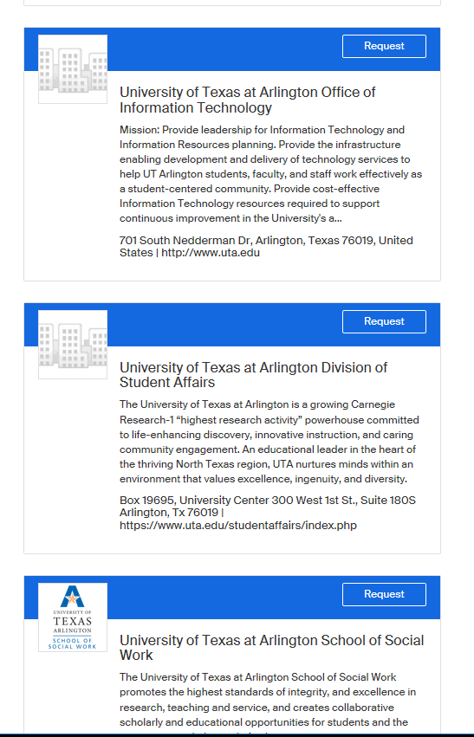
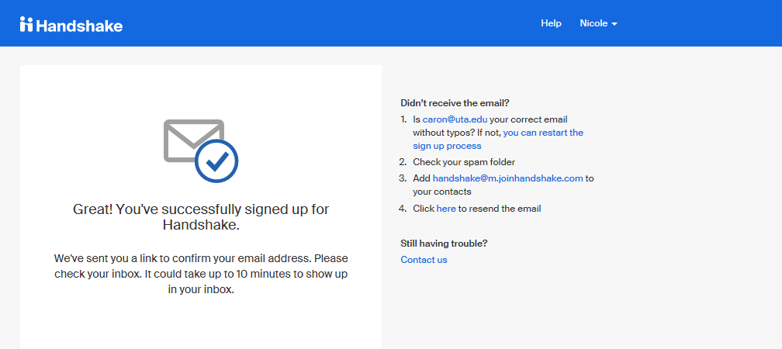
Create a Handshake Account pt. 2
How to:
Once your account is confirmed, request access to your department.
  Every department is listed as “University of Texas at Arlington ‘Department Name.’”
  The Career Development Center has made a landing page for each department on campus.
  *NOTE* If your department has previously used Handshake before, your department owner will have to approve your request. Owners are typically admins or someone who typically posts jobs for your department.

Slide 5
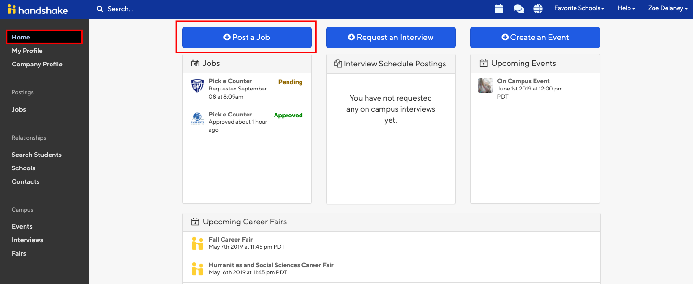
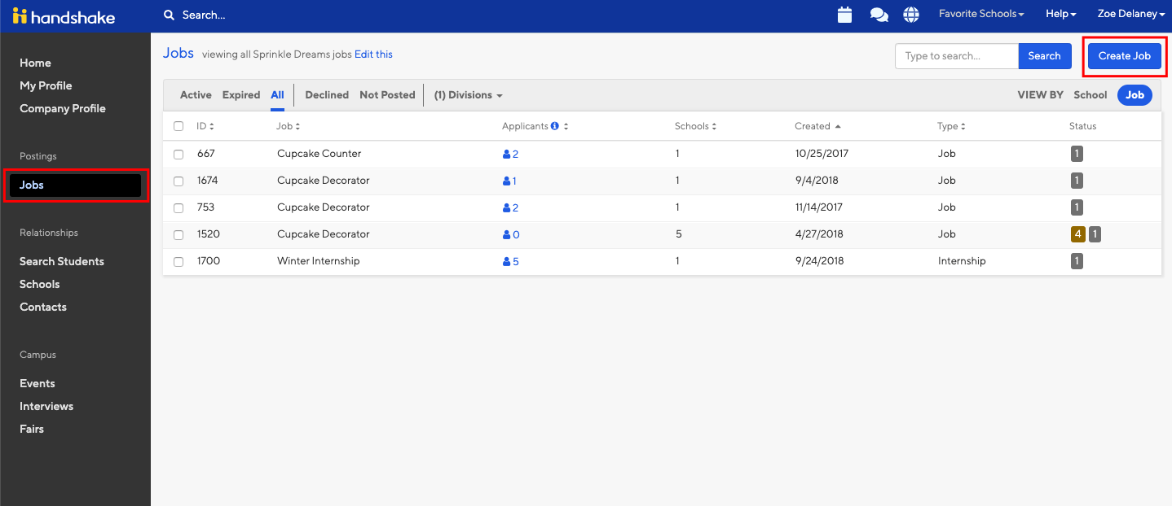
Post a Job in Handshake pt. 1
How to:
To log in to your account, go to: app.joinhandshake.com
  For an employer account, you CANNOT use single sign on.
Start by clicking Post a Job from your home dashboard, or clicking on Jobs in the left hand navigation bar and clicking Create Job in the top right hand corner.

Slide 6
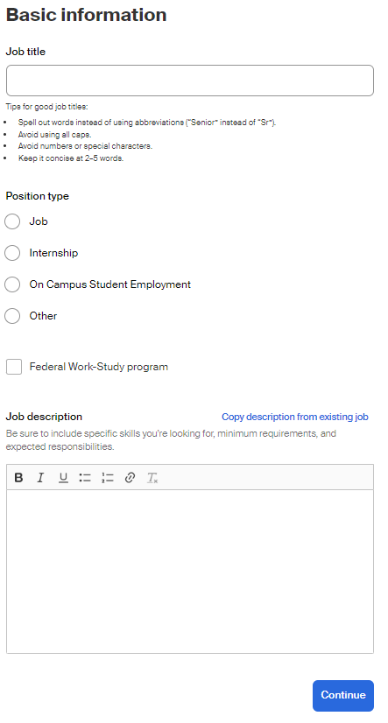
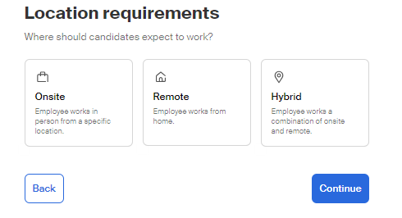
Post a Job in Handshake pt. 2
Job Title : All job titles should include the following naming:
    UTA Student Assistant – Working Title
      Example: UTA Student Assistant – Marketing Intern
    UTA Work-Study Student Assistant – Working Title
      Example: UTA Work-Study Student Assistant – Front Desk
Position Type : Always select “On Campus Student Employment.”
Federal Work-Study Program Box
  By checking the box, only students eligible for work-study can see the position.
  By not checking the box, all students can see the position.
Job Description
  Your job description must include job duties, responsibilities, and necessary qualifications.
Location Requirements
  Please select whether your position is available onsite, remote, or hybrid. For onsite location, please type in “Arlington, TX” for your location.
Notes:
Please always include "UTA" in the front of all job positions. If it is work-study, please make it a habit to include "UTA Work-Study" at the front of the job title.
If your Job Type is incorrectly marked as any other type, Student Employment will not know as we do not have access to the additional job type queues. Therefore, your job posting will be pending until your department notifies us that it has not been reviewed.
Although Student Employment does not provide job descriptions, we can offer tips and suggestions that will help make your job postings stand out:
Embrace Clarity and Detail: Be crystal clear about the role's responsibilities, qualifications, and what sets your department apart. Students are hungry for information, so provide a comprehensive overview that showcases the exciting challenges they'll tackle and the impact they'll make.
Speak Their Language: Appeal to students by adopting a conversational tone that resonates with their aspirations. Address them directly, showcasing how their skills and fresh perspectives will be valued in your dynamic work environment.
Showcase Growth Opportunities: Highlight the growth potential within your department. Students are eager to learn and advance, so emphasize the learning opportunities, mentorship, and potential career paths that await them.
Spotlight Impactful Projects: Feature some of your most innovative projects that students can be a part of. Showcasing real-world applications of their potential contributions will ignite their passion and drive to join your team.
Champion Your Company Culture: Emphasize your department's unique culture and values. Students seek inclusive and supportive environments, so illustrate how your workplace fosters collaboration, creativity, and a sense of belonging.
Be Authentic: Let your department's personality shine through. Students are attracted to authenticity, so don't be afraid to share stories that demonstrate the incredible experiences your current team members have had.
Offer Flexibility and Perks: Flexibility and perks can make your role irresistible. Students appreciate employers who value work-life balance and offer remote options.
Inspire a Greater Purpose: Demonstrate the positive impact your organization makes on the world. Students are eager to contribute to causes that matter, so show how your company is making a difference and how they can be a part of it.
Encourage Creativity and Initiative: Empower students by expressing your openness to their unique ideas and solutions. Showcase that their creativity and initiative will be celebrated and rewarded.
Personalize Your Job Descriptions: Tailor your job descriptions to different roles and audiences. Craft specific descriptions that address the aspirations and interests of students in various fields.
By following these tips, you can show students that your department is not just a place to work but an inspiring journey where they can learn, grow, and make their mark.

Slide 7
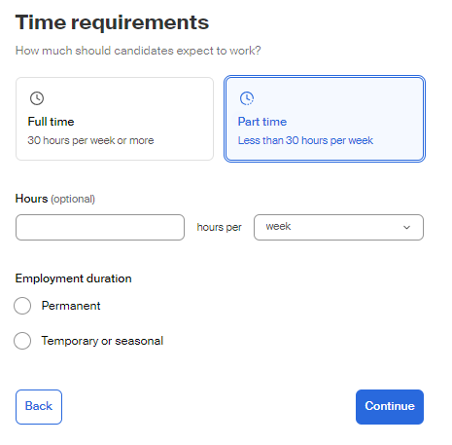
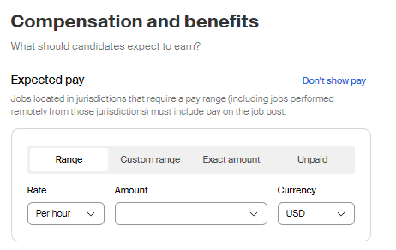
Post a Job in Handshake pt. 3
Time Requirements
  All student employment positions are part-time, and students are only eligible to work up to 19 hours per week.
Employment Duration
  Always select temporary or seasonal.
  The estimated start and end date is dependent on the department.
Compensation
  It is required for pay to be listed on all job positions, whether a range or an exact amount.
Notes:
Employment Duration – As positions are temporary, departments have the choice to have a student work for the academic year and/or semester by semester, depending on their work performance.

Slide 8
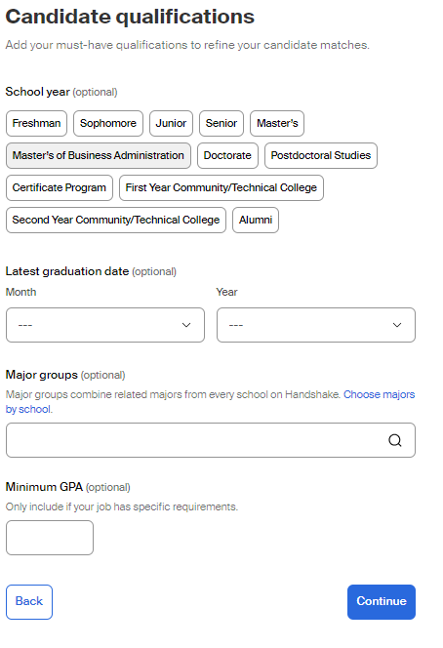
Post a Job in Handshake pt. 4
Preferences are optional
  School Years
  Graduation Date Range
Major Groups
  You can pick specific majors
Minimum GPA

Slide 9
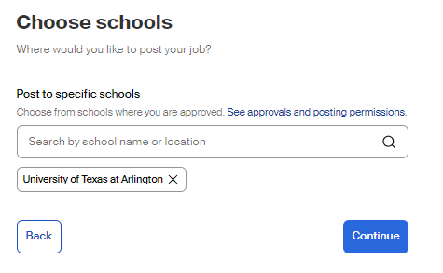
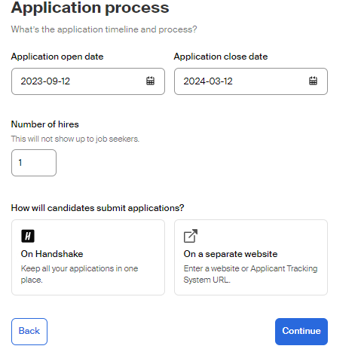
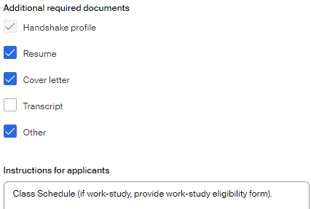
Post a Job in Handshake pt. 5
Add your job posting to the University of Texas at Arlington.
Choose how long you want your job posted by setting a date range (minimum 5 days, maximum 30 days).
Include the number of hires you desire.
Applications can be submitted via Handshake or an external website of your choosing.
Request for additional documents, if needed.

Slide 10
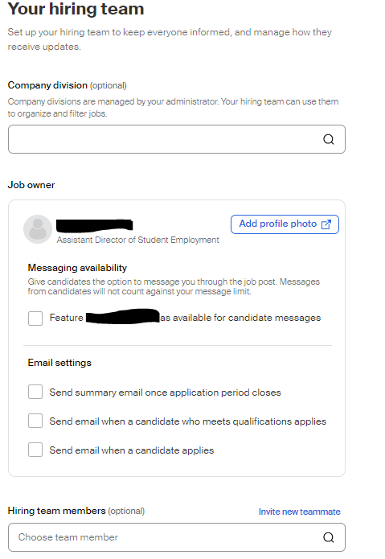
Post a Job in Handshake pt. 6
When posting a job, you are the designated contact who can receive emails on who has applied to your job posting.
You can also include additional contacts.
Once completed, you have the option to review your job posting before posting it.
Once posted, you will receive an email confirmation when Student Employment has approved your job posting.
Notes:
Student Employment can take 24-48 hours to approve a job posting. If you need immediate assistance, please do not hesitate to reach out to us.

Slide 11
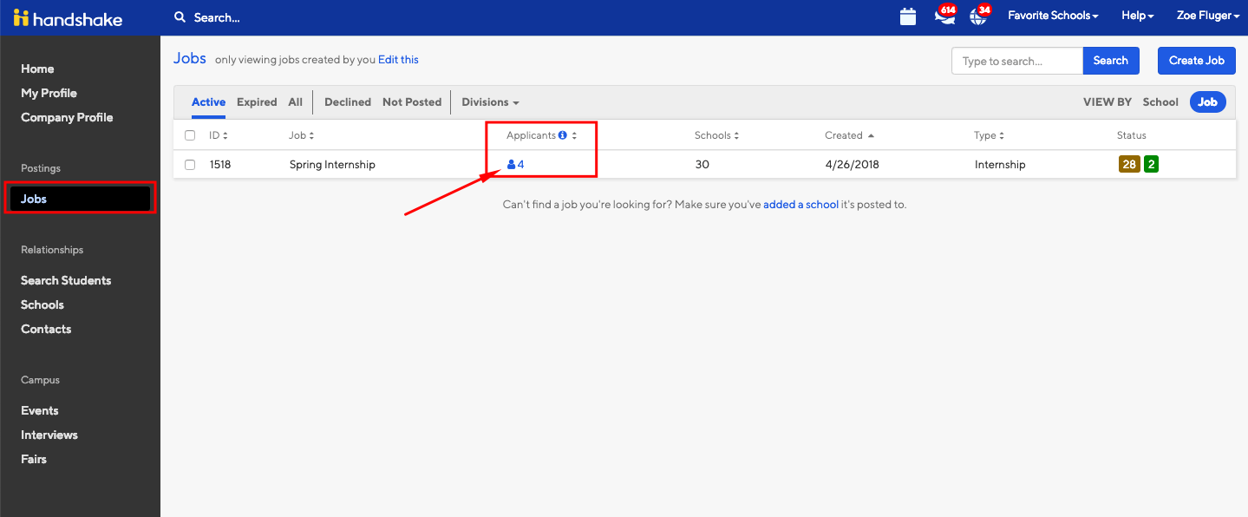
Accessing your Applicants pt. 1
Accessing Applications and Documents:
To log in to your account, go to: app.joinhandshake.com
  For an employer account, you CANNOT use single sign on
Once you are logged in, Click “Jobs” in the left hand navigation bar.
Locate the job you’d like to view applicants for.
  Helpful hints – you can search job titles or job id’s in the search bar. You can also click on the “Expired” tab at the top of the page if you are trying to locate a job that has expired.
  Click the number and person icon under the Applications column, connected to the job you wish to view the applicants for.

Slide 12
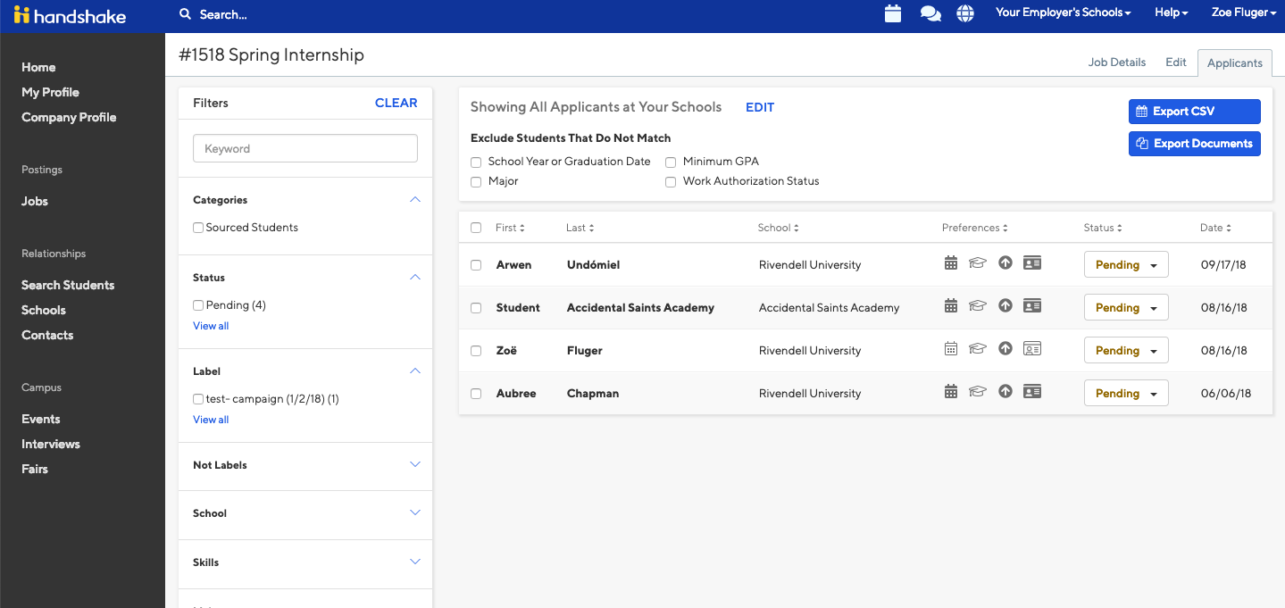
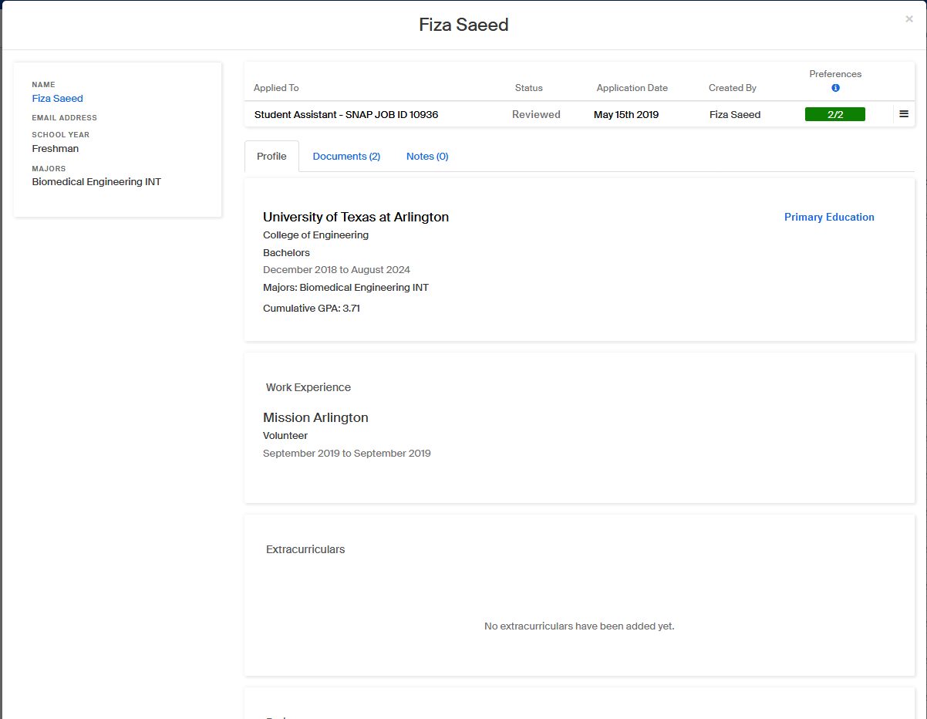
Accessing your Applicants pt. 2
Reviewing Resumes:
Once the page loads, you will be brought directly to the “Applicants” page for your specific job posting.
By clicking on the applicant’s name, you can access their Handshake profile and application documents.
You can also download an Excel sheet or a document packet with all of the applicant’s resumes or required documents.

Slide 13
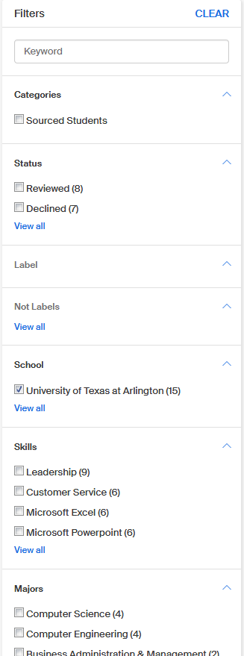
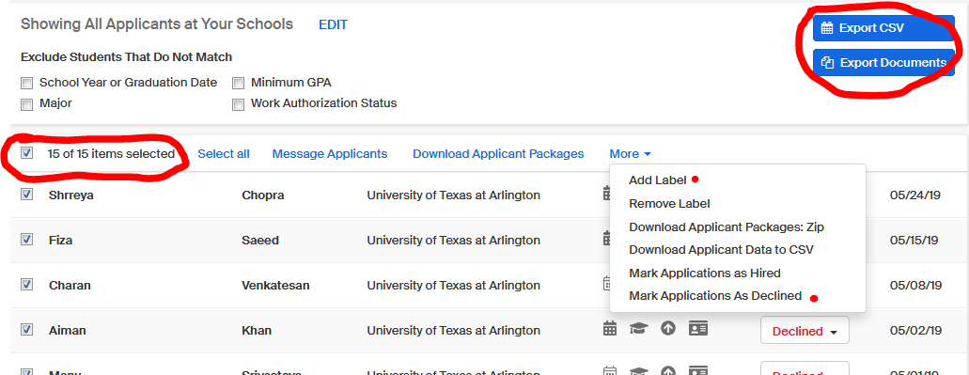
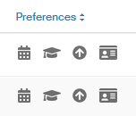
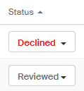
Accessing your Applicant pt. 3
Finding the best candidate
By selecting all students, you can message all applicants, or add a label.
You can use filters to sort by different categories for different skillsets.
If all four boxes are dark grey as shown in the picture, it means the applicant has all the preferences/skillsets you posted in your job description. If only three of the four are selected, it means they are missing one of the preferences.
You can decline applicants individually or as a group if you aren’t going to hire them. (This lets the student know they aren’t moving forward in the hiring process.) If you are hiring a student, please mark them as hired. To do this, change their status.

Slide 14
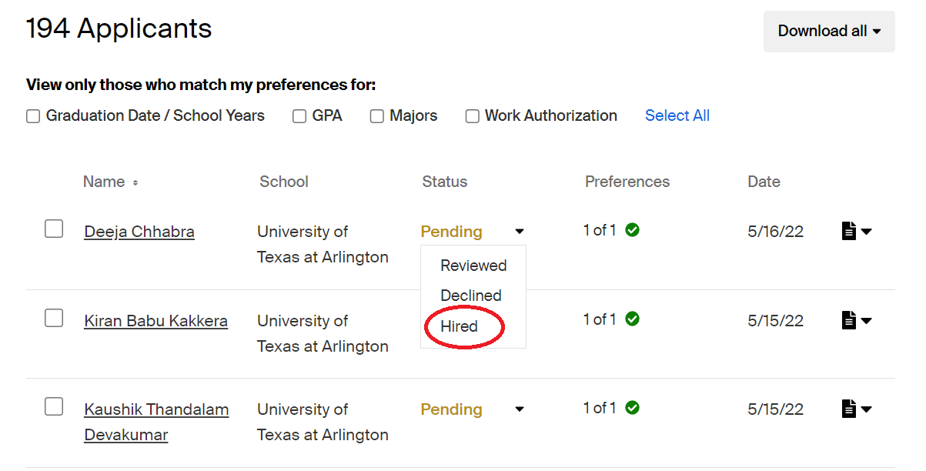
Expiring a Posting pt. 1
Once you have hired your student(s), please change the hired student's status to 'hired' and decline the remaining applicants. ​
Navigate to the job posting -> Applicants -> Status ​

Slide 15
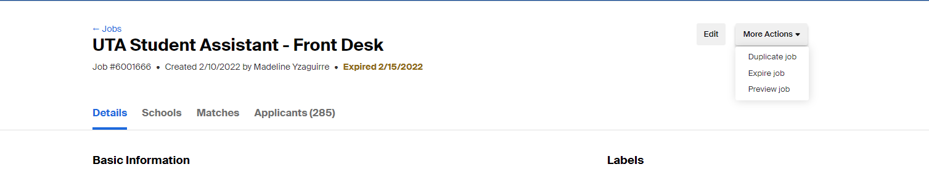
Expiring the Posting pt. 2
Expire the job posting once you have filled the position.​
This prevents new applicants from applying and getting lost in the process.​
Select the job you wish to expire -> ‘More actions’ -> ‘Expire Job.’​

Slide 16
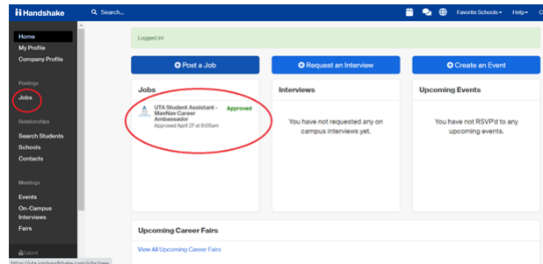
Duplicating a Job Posting pt. 1
Log into Handshake and select jobs on the left side pane or if you see it on your screen click that as well.​
Notes:
We encourage departments to please do not reset job postings. For best practices, please expire your job posting, then duplicate for up to 30 days to receive a fresh applicant pool. If you are hesitant to do this because previous applicants may reapply, be sure to download your candidate pool report so that you are able to deny those applications you are not interested in.

Slide 17
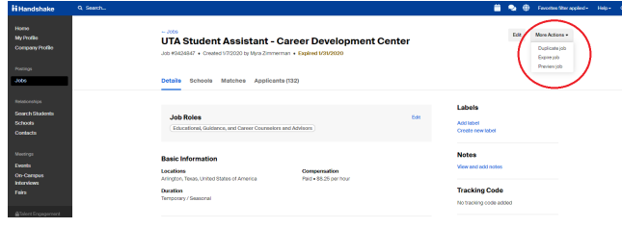
Duplicating a Posting pt. 2
Once you select the job your screen will look like the screenshot below. From here select ‘more actions' ’and then it will drop down to show different action items. You will select 'duplicate job.'​
Notes:
Once you select duplicate, you will be able to edit the job as if you were posting it for the first time. Carry on as if you were posting a normal job. Give the new position 24 – 48 hours to be approved.

Slide 18

Handshake Support & Resources
If you find that you need more Handshake resources or to submit a support ticket on Handshake, be sure to visit their help center (support.joinhandshake.com) Select 'Contact Support' or click on the message icon shown in the image below to submit a support ticket:
Notes:
While Student Employment oversees Handshake for UTA, there are certain aspects of the platform that we cannot directly edit. In specific cases such as transferring ownership when a Handshake account owner is no longer with UTA, removing a previous employee from one department to another, or deleting a Handshake account, you need to submit Handshake Support Tickets for assistance. If you encounter any difficulties while submitting your ticket, please feel free to contact Student Employment for further assistance.

Slide 19
Contact Us
Location: E.H. Hereford University Center, Suite 180S
Office Hours: Monday - Friday 8:00 am - 5:00 pm
Phone: 817-272-2932
Email: studentemployment@uta.edu
Website: www.uta.edu/careers
Handshake Website: uta.joinhandshake.com

