Slide 1
Driving Understanding With Dashboards
Paul Kelsey
Senior Assurance Manager
BDO

Slide 2
Objectives
Consider frequent weaknesses in traditional reporting
Define dashboard
Discuss the benefits and challenges of dashboards
Outline key features of effective dashboards and considerations for getting started
Demonstrate creation of the classic speedometer image in
Excel

Slide 3
Consider Frequent Weaknesses in Traditional Reporting

Slide 4
Weaknesses in Traditional Reporting
“While producing reports may be standard protocol, the capacity for understanding and acting on financial information varies widely from organization to organization. More often than not . . . organizations dutifully produce the numbers but then do not leverage them to advance strategic internal conversations.”
– Neela Pal, Fiscal Management Associates

Slide 5
Weaknesses in Traditional Reporting
A key aspect of traditional financial reporting is a comparison of budget and actual, but when is being on budget a bad thing?
When we don’t account for timing differences
When we have opportunities to be better than budget
When under budget means behind schedule
When our strategic interest and budget are misaligned

Slide 6
Weaknesses in Traditional Reporting
Traditional financial reporting is often provided in some form to those with varied level of financial training/experience and varied perspectives of organizational priorities. This impacts
How quickly they can understand the information
Whether or not they can translate the numbers to strategic actions for themselves
Whether or not they can provide feedback that helps others focus on strategic actions that align with the same goals

Slide 7
Weaknesses in Traditional Reporting
Traditional operational reporting is often provided outside the context of other realities, such as
Employment levels
Financial data

Slide 8
Define Dashboard

Slide 9
Define Dashboard
“A visual display of the most important information needed to achieve one or more objectives; consolidated and arranged on a single screen so the information can be monitored at a glance”
- Few, S. Information Dashboard Design: The Effective Visual Communication of Data.O’Reilly Media

Slide 10
Example - http://www.uspto.gov/dashboards/patents/main.dashxml

Slide 11
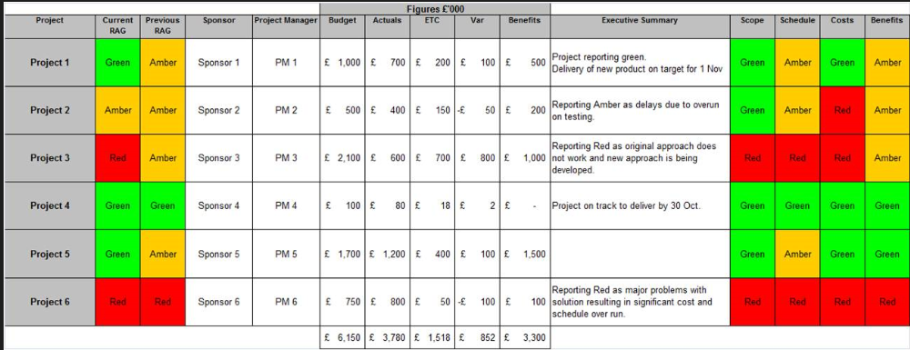
Example - http://www.pmmajik.com/simple-pmo-dashboard/

Slide 12
Benefits of Dashboards

Slide 13
Benefits of Dashboards
Dashboards push the organization to clearly define strategic objectives.
What is it that we want to achieve?
How do we measure whether we are achieving it?
Are there clearly defined limits of what is unacceptable, acceptable and exceptional?

Slide 14
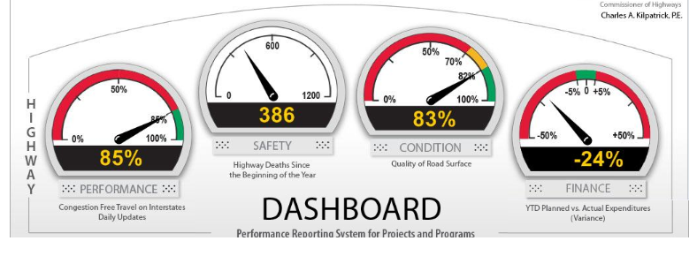
Benefits of Dashboards

Slide 15
Benefits of Dashboards
Dashboards encourage timely strategic refinement.
Clear focus on core objectives helps avoid chasing distractions.
The better understood the present results are, the more quickly and effectively we can fine tune our performance.

Slide 16
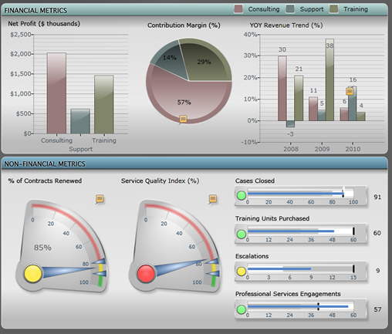
Benefits of Dashboards

Slide 17
Benefits of Dashboards
Dashboards increase insight and understanding
By focusing attention on the critical factors
By better engaging non-accountants – not only because a page of numbers may be off-putting or daunting but also because many see a financial report and think it’s just the accountants who need to care about that information
By combining financial and operational data in ways the financial statements often cannot

Slide 18
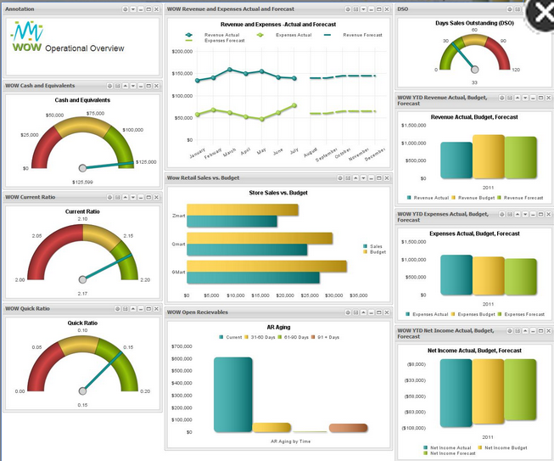
Benefits of Dashboards

Slide 19
Benefits of Dashboards
Dashboards increase results
That which we measure gets done first and best
That which we don’t measure may not get done and probably will not get done well. More importantly, we likely won’t realize it in a timely manner.

Slide 20
Benefits of Dashboards

Slide 21
Challenges of Dashboards

Slide 22
Challenges of Dashboards
Deciding what to track and how to track it may be difficult
Ideally, dashboards need to be automated or at the very least require minimal manual effort. Often this means getting more than one system to share data.
To be useful, the data must be accurate and timely
Customized automated options can be expensive

Slide 23
Challenges of Dashboards

Slide 24
Key Features of Effective Dashboards and Considerations for Getting Started

Slide 25
Key Features of Effective Dashboards
Should fit on a single page, or possibly a page for each critical strategic area
Should be simple to understand
Should employ the best display medium to communicate effectively
Customized automated options can be expensive
Should focus on core strategic goals

Slide 26
Considerations for Getting Started
Identify your core strategic goals
Determine how to measure those goals
Define acceptable and unacceptable levels of achievement
Determine the simplest means to displaying relevant measurements (i.e. build a dashboard that you can maintain)
Focus on:
Who needs to understand this information?
Group images in a logical manner.
Don’t over-clutter.
How often do we need to refresh the data?

Slide 27
Demonstrate creation of the classic speedometer image in Excel

Slide 28
Make Your Own Speedometer in Excel

Slide 29
Create the Color Zones Table
Decide the appropriate range of unacceptable / acceptable results for whatever you are tracking.
The color ranges in the image are based on the running totals above. So "red" will run from 0 to 20, "orange" from 21 through 60, etc.
You don't have to use a 150 point scale, but in a future step the totals need to match. Once you set up a template, just play around to see what you like.

Slide 30
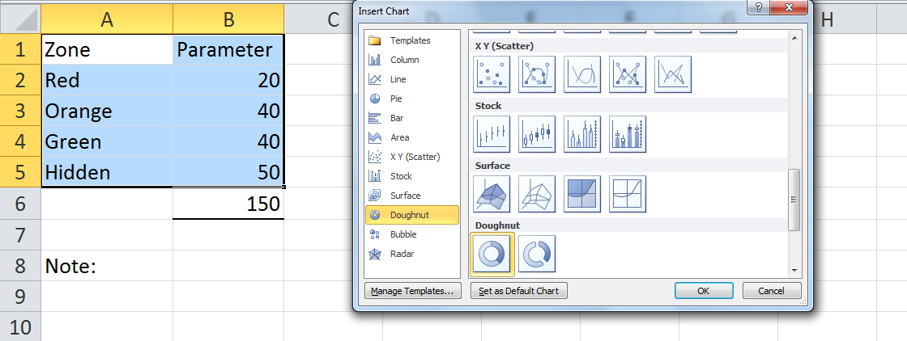
Highlight the data rows and select “Insert Chart”; then find the doughnut chart.

Slide 31
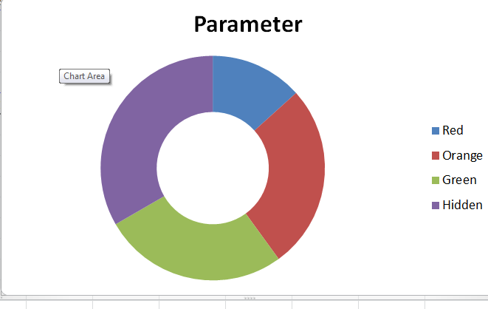
You will get something like this:

Slide 32
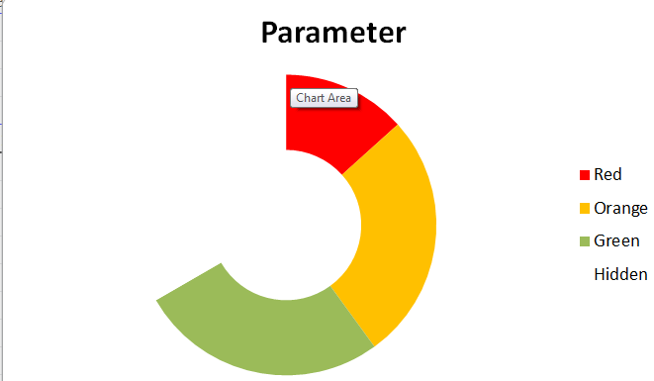
Right click on each section and you will see an option to change colors to match the label names. Then you will have this:

Slide 33
You can then click on and delete the labels, so you have this:

Slide 34
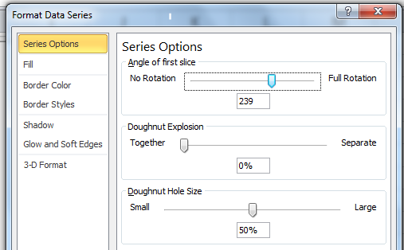
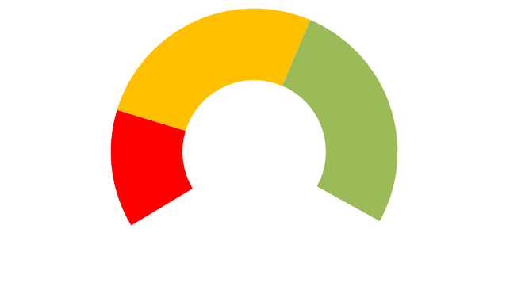
Right click on the doughnut and select “format data series.” Change the rotation bar until the color zones are where you want them.

Slide 35
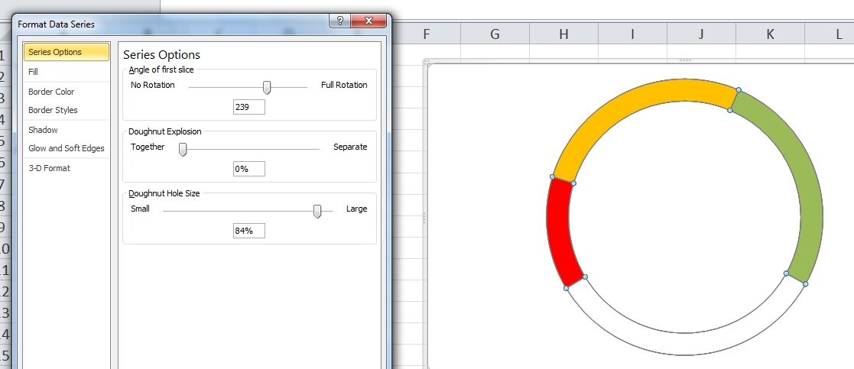
Also using the “format data series”, the last slider can adjust how thick the doughnut is. I’ve make mine smaller:

Slide 36
Next, we will add the “mileage” markers. Before you do this step, you will want to move (by dragging or cut/paste) the image to it’s final location in the file. You probably want the image on a tab separate from the data.

Slide 37
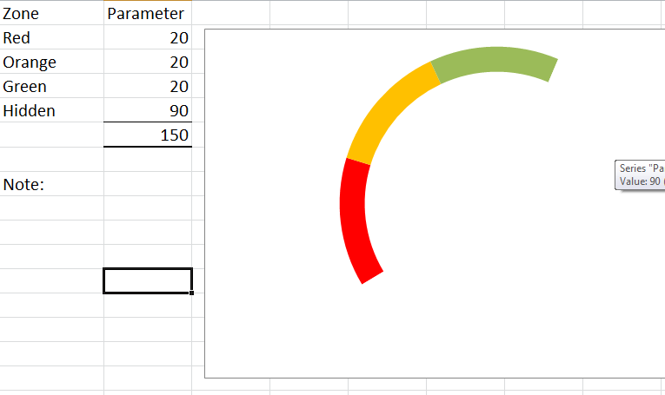
To know where to place the text boxes, temporarily edit your data, but keep the same total by changing “hidden”. For example, this will show you where 0, 20, 40, and 60 are:

Slide 38
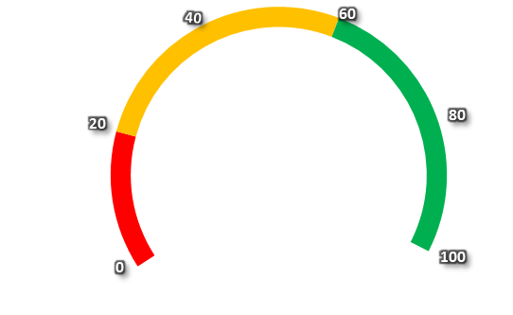
I’ve just marked every 20 “miles” in my example, so I have this now (with the data changed back to the original amounts).

Slide 39
This is your “base image” that will not change as daily data is monitored. Next we will add an example of a specific goal being monitored.

Slide 40
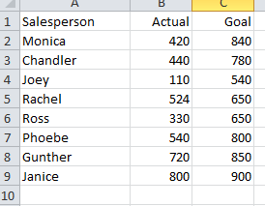
Let’s assume we want to monitor a simple actual sales vs. goal and we have this data, which could be easily updated:

Slide 41
For each individual, a table would be set up like this:

Slide 42
A note about the data updates:
In this scenario, the only data that would need to be updated regularly is the sales/goal table. The other individual tables (i.e. the previous slide) and all of the images are one-time setups.

Slide 43
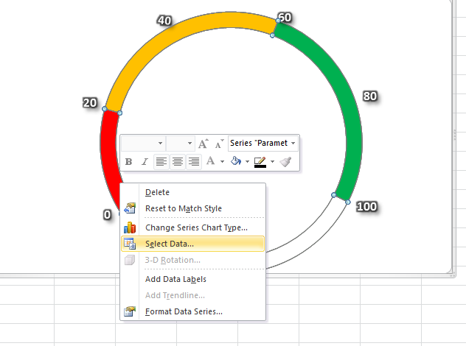
Next, click on the doughnut and choose “select data.”

Slide 44
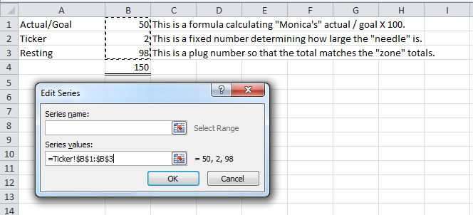
Next, click on the doughnut and choose “select data.” Find the “add” button, and then change “series values” to point to the individual-specific data like this:

Slide 45
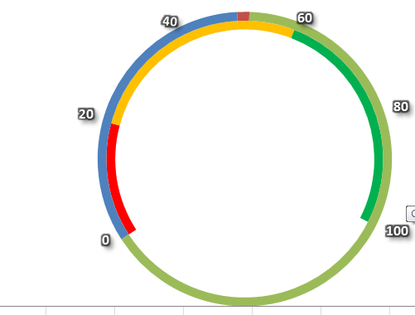
You will see this new image now:

Slide 46
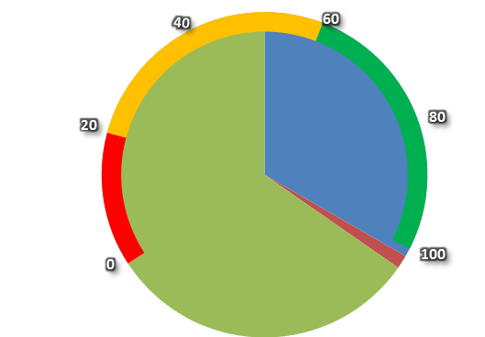
Right click on the outer ring and find the “change chart” option. Select pie chart. Now you will have something like this:

Slide 47
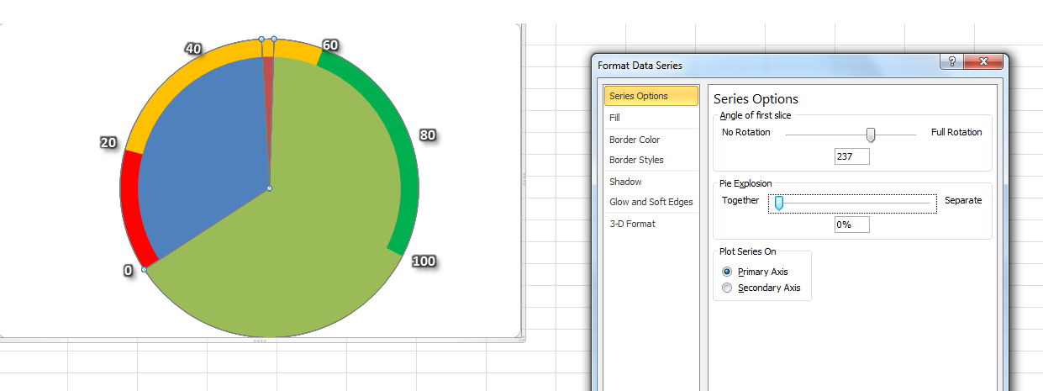
Using the same approach as above, but now for the pie chart, rotate the image using the rotation slider in the “format data series” area. If you zero lines up you are set.

Slide 48
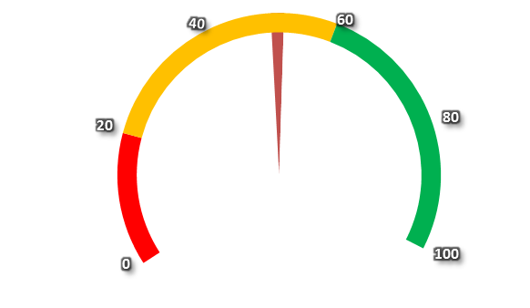
Next, right click on the blue and green portions of the inner pie chart and change the color to white.

Slide 49
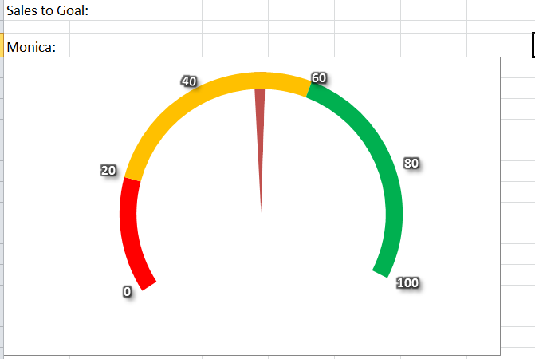
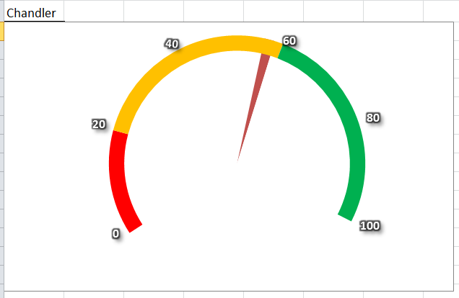
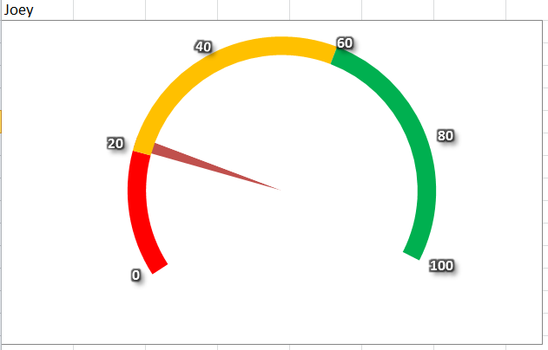
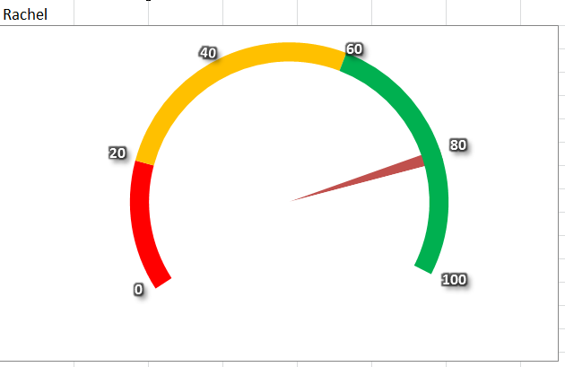
You can fine tune the image by adding labels as needed.

Slide 50
Some other classics:
The thermometer - see instructions at this sight for the images shown below.
http://chandoo.org/wp/2008/06/26/thermometer-charts-in-excel-howto/

Slide 51
Another classic:
The thermometer - see instructions at this sight for the images shown below.
http://chandoo.org/wp/2008/06/26/thermometer-charts-in-excel-howto/

Slide 52
Keep in mind
For a dashboard to be effective, you do not need fancy images. Even a simple bar chart with conditional formatting of the color coding is effective.

Slide 53
I’d love to hear from you as you try out dashboard ideas, and I’m available for questions: pkelsey@bdo.com

